Slide 1
Java –
Introduction to Class

Slide 2
Properties of OOP

Slide 3
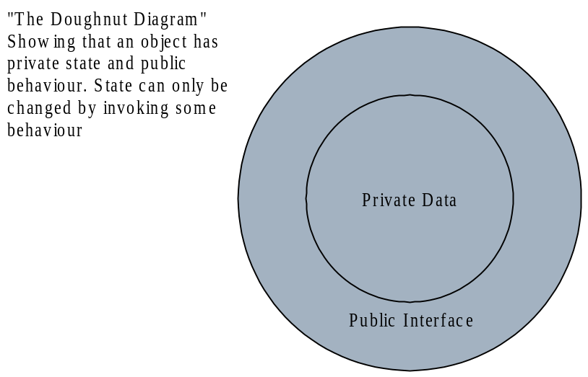
Encapsulation
The data (state) of an object is private – it cannot be accessed directly.
The state can only be changed through its public interface.
This is called encapsulation

Slide 4
Classes

Slide 5
Preparation
Scene so far has been background material and experience
  Variables
  Data Types
  Input and output
  Expressions
  Assignments
  Objects
  Standard classes and methods
  Decisions (if, switch)
  Loops (while, for, do-while)
Now: Experience what Java is really about
  Design and implement objects representing information and physical world objects

Slide 6
Object-oriented programming
Basis
  Create and manipulate objects with attributes and methods that the programmer can specify
Mechanism
  Classes
Benefits
  An information type is designed and implemented once
    Reused as needed
      No need reanalysis and re-justification of the representation

Slide 7
Known Classes
Classes we’ve seen
  String
  Scanner
  System

Slide 8
The Car class

Slide 9
A new example: creating a Car class
What properties does a car have in the real world?
  Color
  Position (x,y)
  Fuel in tank
We will implement these properties in our Car class
  class Car {
  private Color color;
  private int xpos;
  private int ypos;
  private int fuel;
  //...
  }

Slide 10
Car’s instance variables
  class Car {
  private Color color;
  private int xpos;
  private int ypos;
  private int fuel;
  //...
  }
Car
- color
- xpos
- fuel
- ypos
+ …

Slide 11
Instance variables and attributes
Default initialization
  If the variable is within a method, Java does NOT initialize it
  If the variable is within a class, Java initializes it as follows:
    Numeric instance
    variables initialized to 0
    Logical instance
    variables initialized to
    false
    Object instance
    variables initialized to
    null
Car
- color = null
- xpos = 0
- fuel = 0
- ypos = 0
+ …
Notes:
Each instance variable is defined without specifying an initial value. Therefore, whenever a new ColoredRectangle object is to be constructed, Java first initializes the new instance variables to default values. By default, numeric instance variables are initialized to 0, boolean instance variables are initialized to false, and reference-type instance variables are initialized to null.
Thus, every time a new ColoredRectangle object is to undergo construction, new width, height, x, y, window, and color instance variables are created and default initialized for the new object. The numeric attributes width, height, x, and y are initialized to zero and the class-type attributes window and color are initialized to null.
The instance variable definitions specify each of the variable to be private. This modifier indicates that direct access to the instance variables is limited to the class itself. Thus, class ColoredRectangle practices information hiding by encapsulating its attributes.
Defining instance variables to be private is a standard practice. When attributes are private, other classes are forced to use the class’s interface methods to manipulate its attributes. Those interface methods normally are programmed to ensure that the requested manipulations are valid. Because the initial definition of class ColoredRectangle does not provide any methods to give access to the attributes, once a ColoredRectangle is constructed it is immutable. In Section , we introduce several ColoredRectangle methods for accessing and modifying the attributes of a ColoredRectangle object.

Slide 12
Car behaviors or methods
What can a car do? And what can you do to a car?
  Move it
    Change it’s x and y positions
  Change it’s color
  Fill it up with fuel
For our computer simulation, what else do we want the Car class to do?
  Create a new Car
  Change Car’s condition
Each of these behaviors will be written as a method

Slide 13
Creating a new car
To create a new Car, we call:
  Car car = new Car();
Notice this looks like a method
  You are calling a special method called a constructor
  A constructor is used to create (or construct) an object
    It sets the instance variables to initial values
The constructor:
    Car() {
    fuel = 1000;
    color = Color.BLUE;
    }

Slide 14
Constructors
        Car() {
        fuel = 1000;
        color = Color.BLUE;
        }
No return type!
EXACT same
name as class

Slide 15
Our Car class so far
class Car {
private Color color;
private int xpos;
private int ypos;
private int fuel;
  Car() {
  fuel = 1000;
  color = Color.BLUE;
  }
}
class Car {
private Color color =
Color.BLUE;
private int xpos;
private int ypos;
private int fuel = 1000;
  Car() {
  }
}

Slide 16
Our Car class so far
class Car {
private Color color =
Color.BLUE;
private int xpos = 0;
private int ypos = 0;
private int fuel = 1000;
  Car() {
  }
}
Called the default constructor
  The default constructor has no parameters
  If you don’t include one, Java will SOMETIMES put one there automatically
Car
- color = Color.BLUE
- xpos = 0
- fuel = 1000
- ypos = 0
+ Car()
+ …

Slide 17
Another constructor
Another constructor:
  Car (Color c, int x, int y, int f) {
  color = c;
  xpos = x;
  ypos = y;
  fuel = f;
  }
This constructor takes in four parameters
The instance variables in the object are set to those parameters
This is called a specific constructor
  An constructor you provide that takes in parameters is called a specific constructor

Slide 18
Our Car class so far
Car
class Car {
private Color color =
Color.BLUE;
private int xpos = 0;
private int ypos = 0;
private int fuel = 1000;
  Car() {
  }
  Car (Color c, int x, int y, int f) {
  color = c;
  xpos = x;
  ypos = y;
  fuel = f;
  }
}
- color = Color.BLUE
- xpos = 0
- fuel = 1000
- ypos = 0
+ Car()
+ Car (Color, int, int, int)
+ …

Slide 19
Using our Car class
Now we can use both our constructors:
  Car c1 = new Car();
  Car c2 = new Car (Color.BLACK, 1, 2, 500);
c1
c2
Car
Car
- color = Color.BLUE
- xpos = 0
- color = Color.BLACK
- xpos = 1
- fuel = 1000
- ypos = 0
- fuel = 500
- ypos = 2
+ Car()
+ Car (Color, int, int, int)
+ …
+ Car()
+ Car (Color, int, int, int)
+ …

Slide 20
So what does private mean?
Note that it’s a
different class!
Consider the following code
  class CarSimulation {
    public static void main (String[] args) {
  Car c = new Car();
  System.out.println (c.fuel);
  }
  }
Recall that fuel is a private instance variable in the Car class
Private means that code outside the class CANNOT access the variable
  For either reading or writing
Java will not compile the above code
  If fuel were public, the above code would work

Slide 21
So how do we get the fuel of a Car?
Via accessor methods in the Car class:
  public int getFuel() {
  return fuel;
  }
  public Color getColor() {
  return color;
  }
As these methods are within the Car class, they can read the private instance variables
As the methods are public, anybody can call them
public int getYPos() {
return ypos;
}
public int getXPos() {
  return xpos;
  }

Slide 22
So how do we set the fuel of a Car?
Via mutator methods in the Car class:
public void setFuel (int f) {
fuel = f;
}
public void setColor (Color c) {
color = c;
}
As these methods are within the Car class, they can read the private instance variables
As the methods are public, anybody can call them
public void setXPos (int x) {
xpos = x;
}
public void setYPos (int y) {
ypos = y;
}

Slide 23
Why use all this?
Car
These methods are called a
get/set pair
  Used with private variables
Our Car so far:
- color = Color.BLUE
- xpos = 0
- fuel = 1000
- ypos = 0
+ Car()
+ Car (Color, int, int, int)
+ void setXPos (int x)
+ void setYPos (int y)
+ void setPos (int x, int y)
+ void setColor (Color c)
+ void setFuel (int f)
+ int getFuel()
+ int getXPos()
+ int getYPos()
+ Color getColor()
+ …

Slide 24
Back to our specific constructor
class Car {
private Color color =
Color.BLUE;
private int xpos = 0;
private int ypos = 0;
private int fuel = 1000;
Car (Color c,
int x, int y, int f) {
color = c;
xpos = x;
ypos = y;
fuel = f;
}
}
class Car {
private Color color =
Color.BLUE;
private int xpos = 0;
private int ypos = 0;
private int fuel = 1000;
Car (Color c,
int x, int y, int f) {
setColor (c);
setXPos (x);
setYPos (y);
setFuel (f);
}
}

Slide 25
Back to our specific constructor
Using the mutator methods (i.e. the ‘set’ methods) is the preferred way to modify instance variables in a constructor

Slide 26
So what’s left to add to our Car class?
What else we should add:
  A mutator that sets both the x and y positions at the same time
  A means to “use” the Car’s fuel
Let’s do the first:
    public void setPos (int x, int y) {
    setXPos (x);
    setYPos (y);
    }
Notice that it calls the mutator methods

Slide 27
Using the Car’s fuel
Whenever the Car moves, it should burn some of the fuel
  For each pixel it moves, it uses one unit of fuel
    We could make this more realistic, but this is simpler
public void setXPos (int x) {
xpos = x;
}
public void setYPos (int y) {
ypos = y;
}
public void setXPos (int x) {
fuel -= Math.abs
(getXPos()-x);
xpos = x;
}
public void setYPos (int y) {
fuel -= Math.abs
(getYPos()-y);
ypos = y;
}

Slide 28
Using the Car’s fuel
public void setPos (int x, int y) {
setXPos(x);
setYPos(y);
}
Notice that to access the instance variables, the accessor methods are used
Math.abs() gets the absolute value of the passed parameter

Slide 29
The main() method
Consider a class with many methods:
public class WhereToStart {
  public static void foo (int x) {
    // ...
}
  public static void bar () {
    // ...
}
  public static void main (String[] args) {
    // ...
}
}
Where does Java start executing the program?
  Always at the beginning of the main() method!

Slide 30
Running a class without a main() method
Consider the Car class
  It had no main() method!
  Create another class named “CarSimulation” where main function and Car class is declared.
So let’s try running it…

